Slide 2
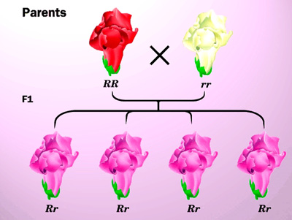
Incomplete Dominance
Is when a dominant trait does not completely mask a recessive trait. The result is a trait that is a mix of the two.
ex.
 | R | r
R
R

Slide 3
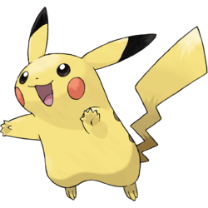
Example Problem 2
 | L | l
L
l
In the pokemon Pikachu the trait for long ears (LL) is incompletely dominant with the recessive short ear trait (ll). What will the resulting offspring be when crossing two Heterozygous (Ll) pikachu?
LL
Ll
LL
Ll
ll
ll

Slide 4
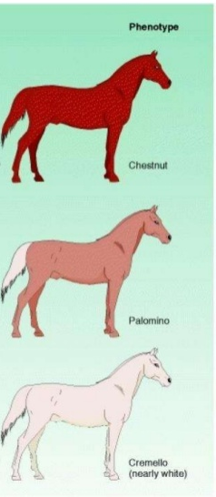
Incomplete Dominance
C = Dominant (Chesnut)
Cc = Heterozygous (Palomino)
c = recessive (Cremello)
If a Chestnut colored horse crossed with an with a Palomino colored horse what is the probability of getting an offspring with a Chestnut coat?

Slide 5
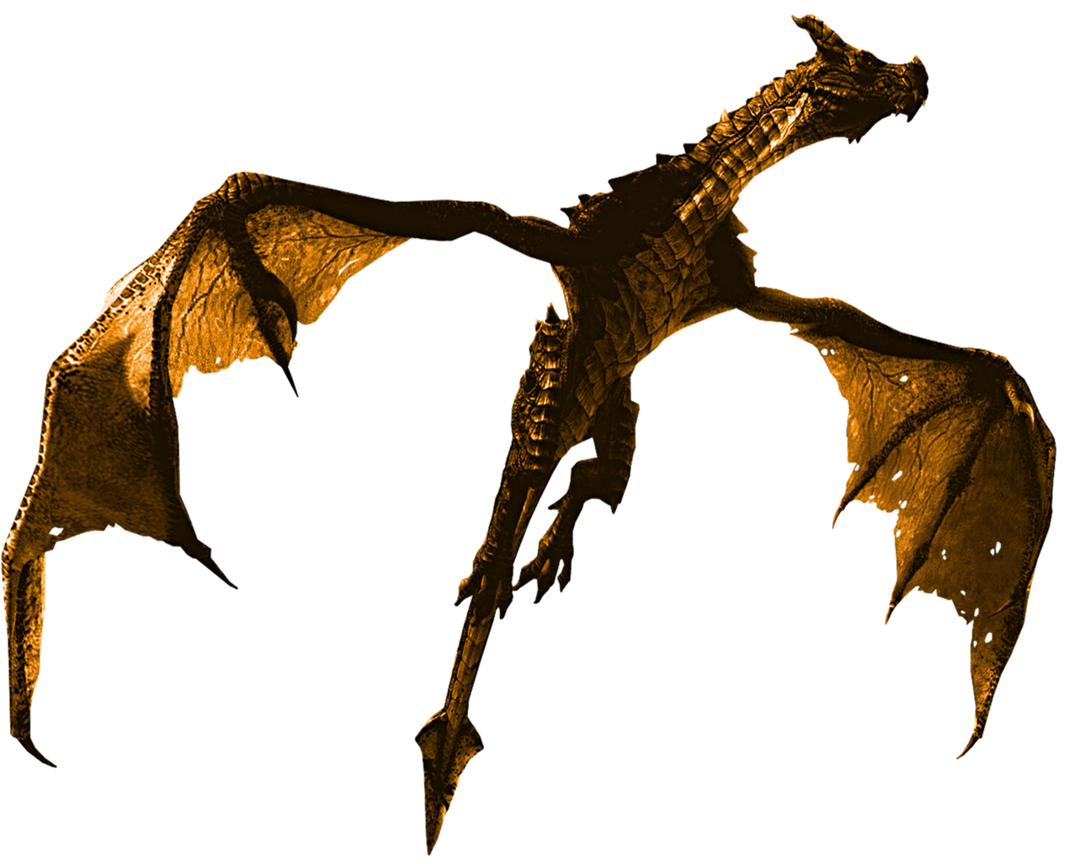
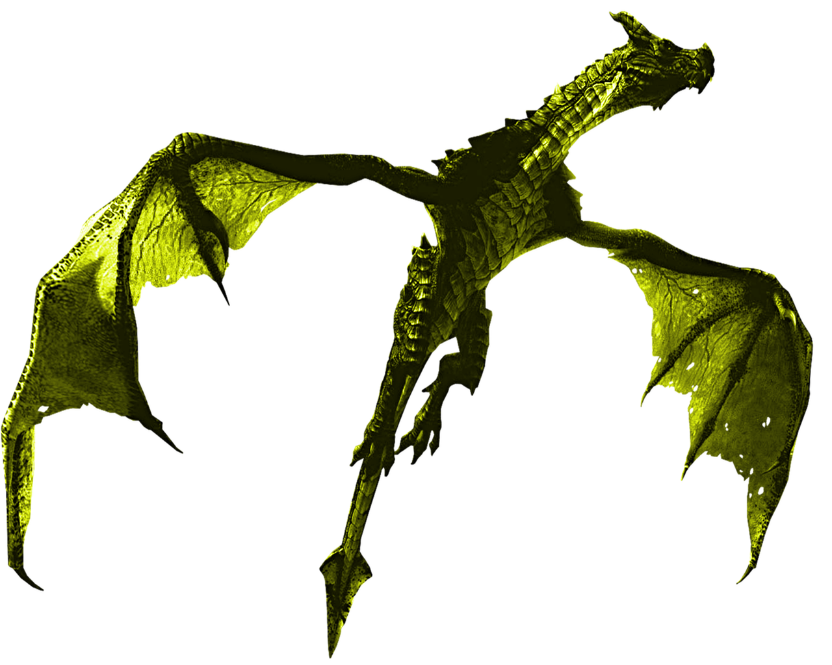
Example Problem 4
In Dragons, Red skin color (BB) is dominant and yellow skin is recessive (bb). However this trait exhibits incomplete dominance. What offspring will I get if I cross a Homozygous recessive, with a Heterozygote?
Hint: what do you know about mixing colors?

Slide 6
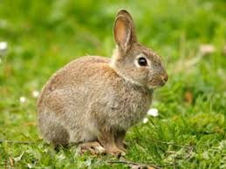
 | B | b
b
b
B= Dominate (Black Fur)
b= recessive (Brown Fur)

Slide 7
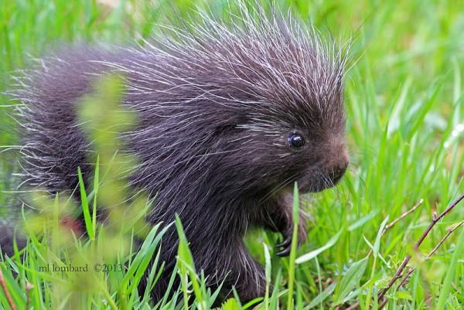
 | Q | q
Q
q
Q= Dominant (Long Quills)
q= recessive (Short Quills)

Slide 8
 | L | l
L
l
L= Long Ears
l= short ears
LL
ll

Slide 9
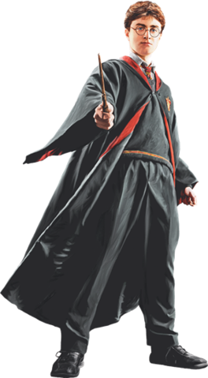
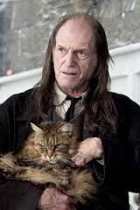
 | M | M
M
m
M= Wizard
m= muggle

Slide 10
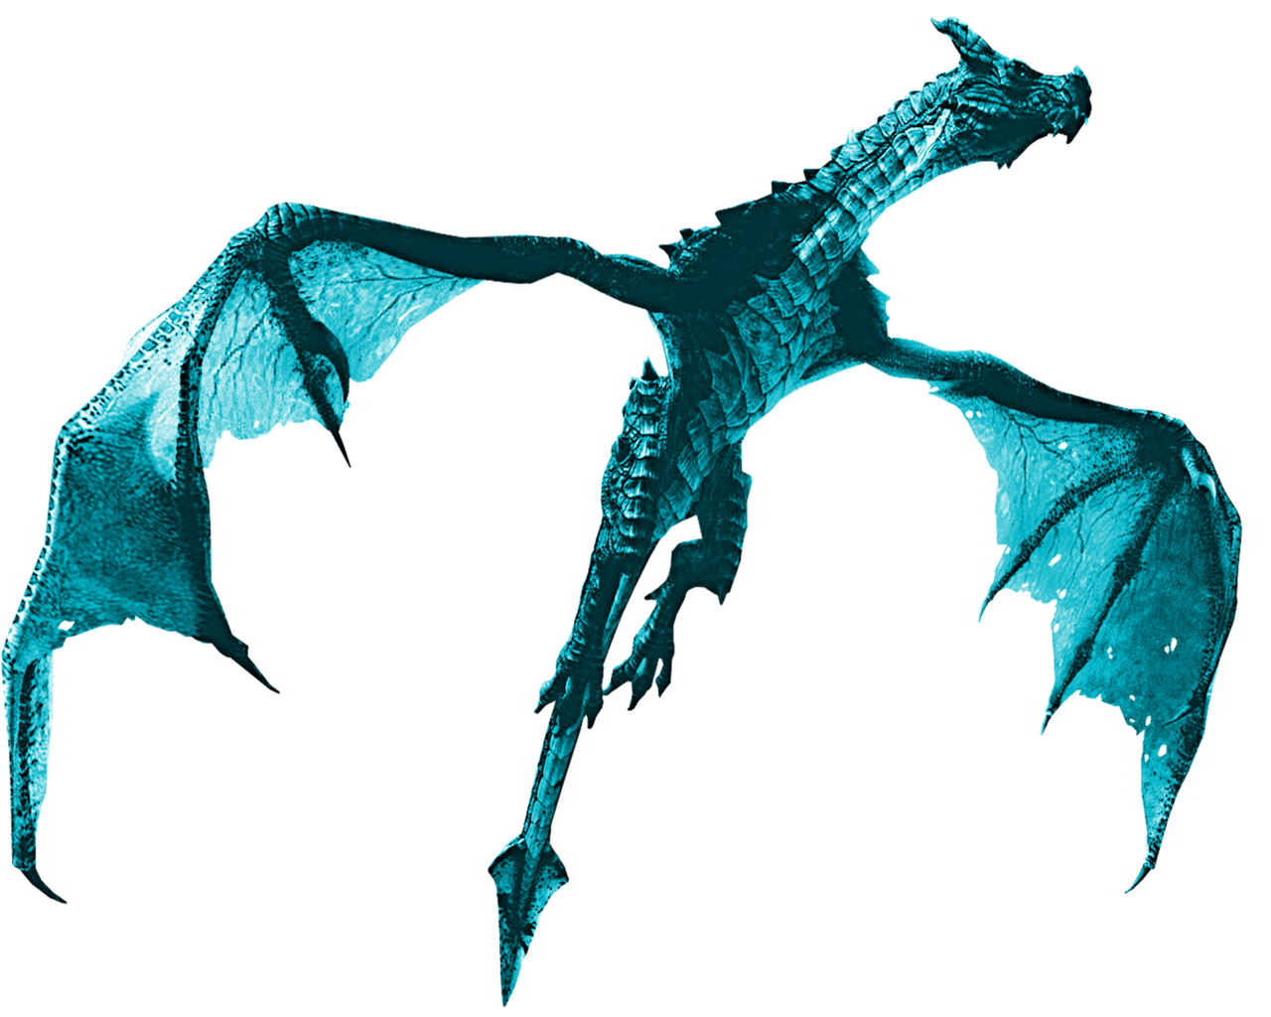
 | D | d
D
d
D= Red Dragon
d= Blue Dragon

Slide 11


I’m a pokemon breeder. I want to cross a shellder with a hitmonchan. But it has to be a purple! Purple is the recessive trait (p) and Brown is the dominant trait (P). X
What are my chances of getting a purple “Shellchan” if one parent is a heterozygote and the other is a homozygous dominant?

Slide 12
Bellwork
I’m a pokemon breeder. I want to cross a shellder with a hitmonchan. But it has to be a purple! Purple is the recessive trait (p) and Brown is the dominant trait (P). X
What are my chances of getting a purple “Shellchan” if one parent is a heterozygote and the other is a homozygous dominant?

Slide 13
Complete Dominance
W= Dominant (Widow’s Peak)
e= recessive (Even Hairline)
If a heterozygote crossed with another heterozygote what is the probability of getting an offspring with an even hairline?

Slide 14
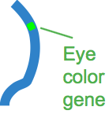
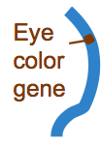
 | e | e
E
E
DAD
Brown Eyes = E
Green Eyes = e
Ee
Ee
MOM
Ee
Ee

Slide 15
 | e | e
E
e
Bellwork 3/7- Solve
Brown Eyes = E
Green Eyes = e
DAD
Ee
Ee
MOM
ee
ee

Slide 16
Freckles = F
non-freckles = f
 | F | F
f
f
Practice:
Ff
Ff
Ff
Ff

Slide 17
Freckles = F
non-freckles = f
 | F | f
F
f
Practice:
FF
Ff
Ff
ff

Slide 18
Tongue Roller = R
non-roller = r
 | R | r
r
r
Practice:
Rr
rr
Rr
rr

Slide 19
Punnett 4 Square!
Start out playing with our table groups
IF I think you are doing well then I may allow you to play with your friends
Step 1: Solve the Punnett Square with your group.
Step 2: Play 4 Square. But, in order to throw it/pass it to another square you must either call out homozygous/ heterozygous of the square you are going to throw to.
Step 3: At the end of each round write down the winner’s square: Genotype/ Phenotype ex. LL long ears

